Slide 1
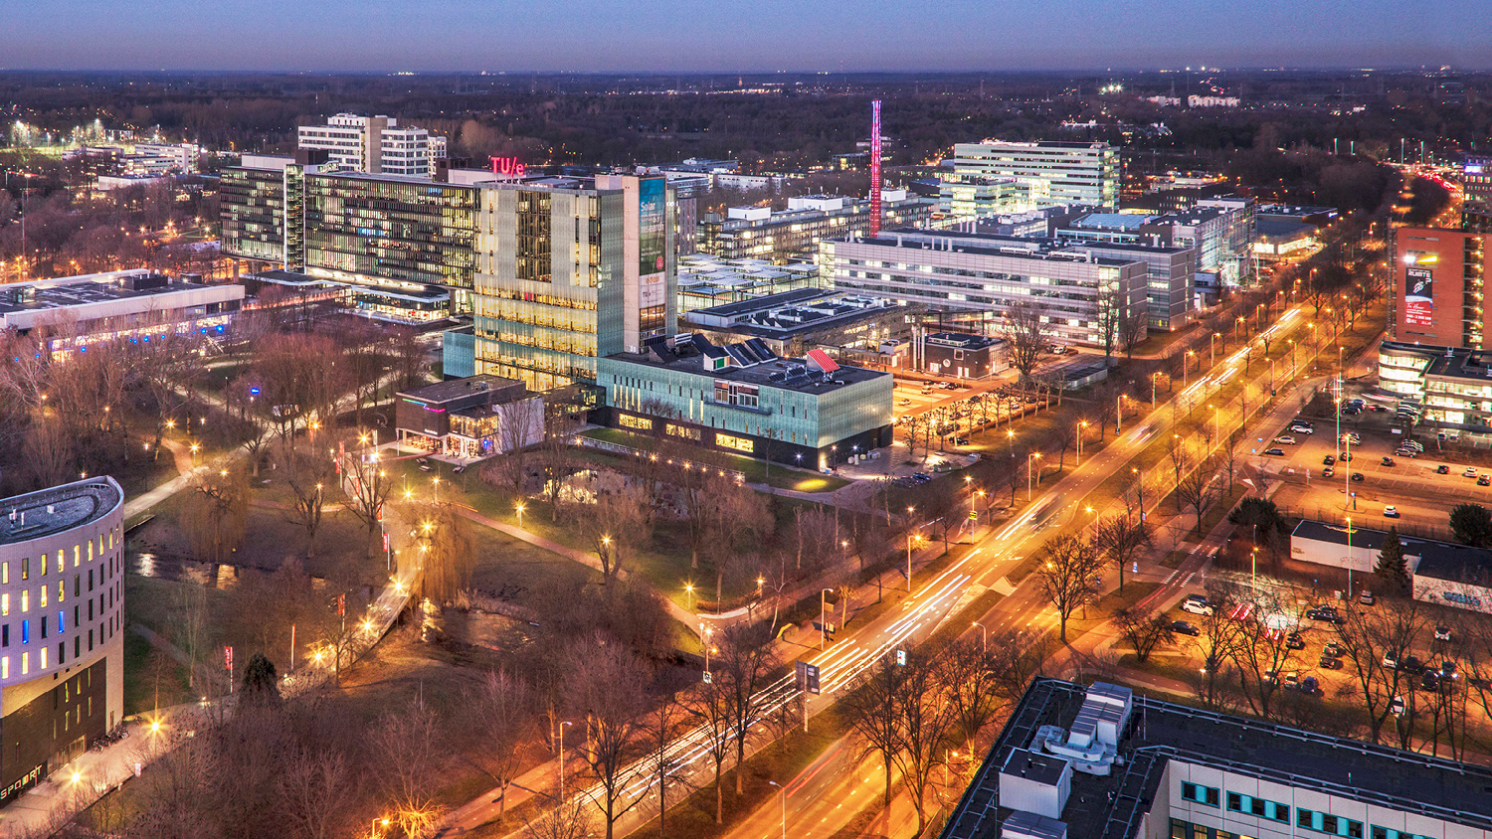
2021 AutoRef – Meeting III
WEDNESDAY, 16 March 2022
Guilherme, Project Manager, PDEng Trainee MSD 2022
1
2o21 MSD AutoRef Project
1

Slide 2
AGENDA
Project progress
Architecture document
First rules implementation
Second rules implementation
Questions
2o21 MSD AutoRef Project

Slide 3

AutoRef - Progress
 | Week
Project activities schedule | 1 | 2 | 3 | 4 | 5 | 6
 | 10/02-17/02 | 17/02-24/02 | 24/02-03/03 | 03/03-10/03 | 10/03-17/03 | 17/03-24/03
Project Management Plan creation
2020 MSD project documents review
Hardware and software options evaluation
Project scope definition
New requirements creation
System architecture definition
Software creation
Software integration
Systems test
Real robot soccer match simulation
Documentations and main deliverables finished
2o21 MSD AutoRef Project

Slide 4
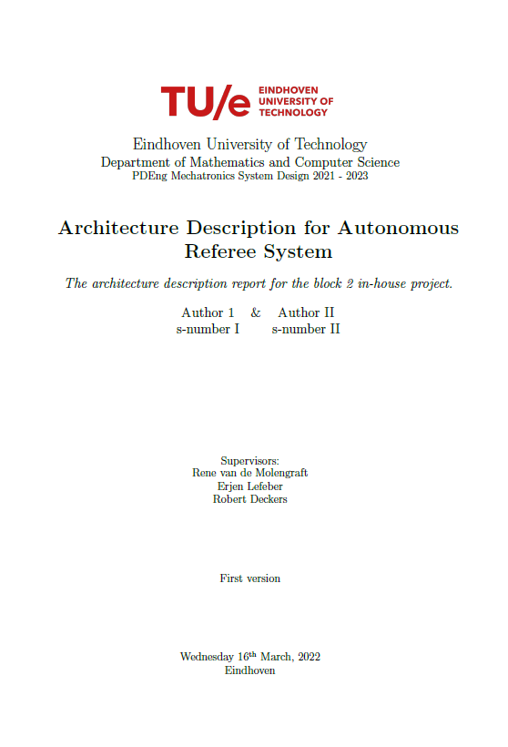
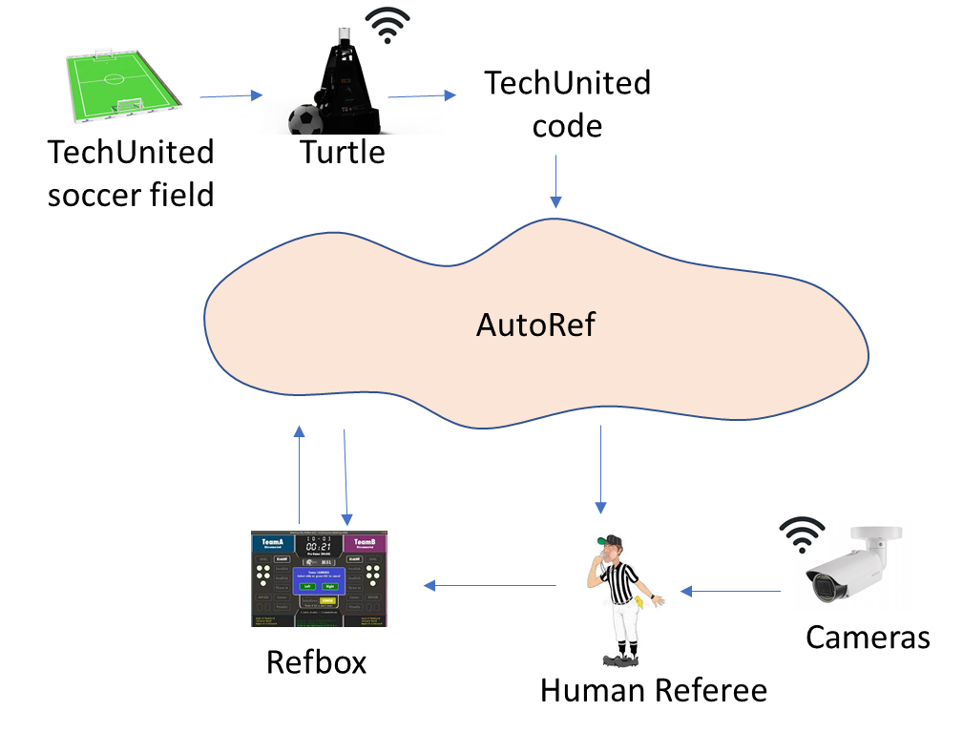
Architecture description
1. Introduction
1.1 Goal
1.2 Proposed Scope
1.3 Application
1.4 Technical Design
1.5 Realisation
2. Stakeholders and Concerns
3. Environment Analysis
4. Models and Views
Main block for AutoRef
Environment Analysis

Slide 5
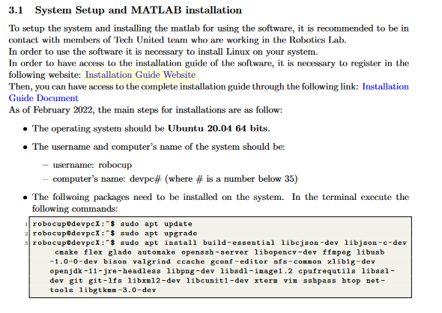
Code explanation
Code explained for each block function

Slide 6
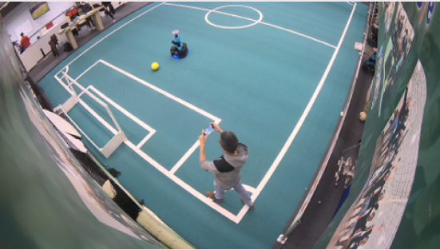
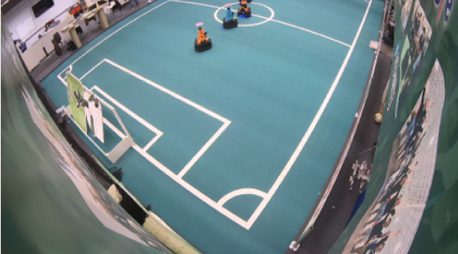
AutoRef - Progress
Rule 1 – Ball IN/OUT pitch
Created individual block functions by the design team
Integrated block function in the same file
Rule test with real data from TURTLES
Created scenarios for data acquisition and validation
Ball crossing the line
Bal IN/OUT
2o21 MSD AutoRef Project

Slide 7
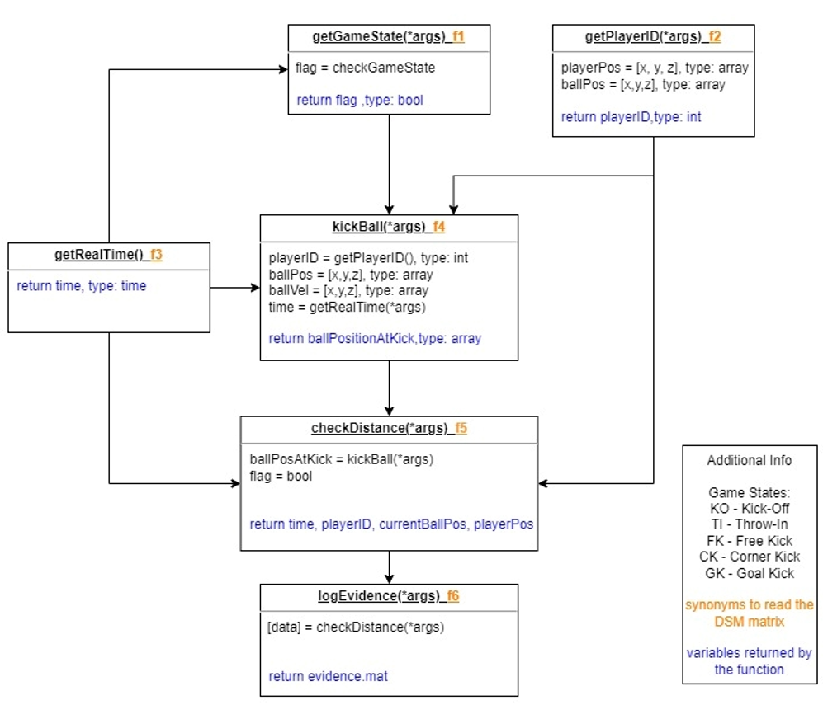
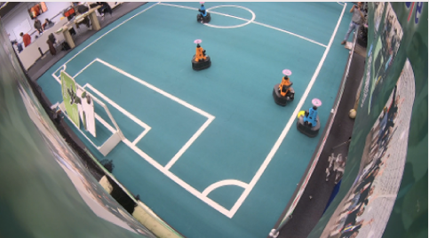
AutoRef - Progress
Rule 2 – Free rolling of ball of 0.5 m
Created individual block functions by the design team
Created scenarios for data acquisition and validation
Throw IN
2o21 MSD AutoRef Project

Slide 8
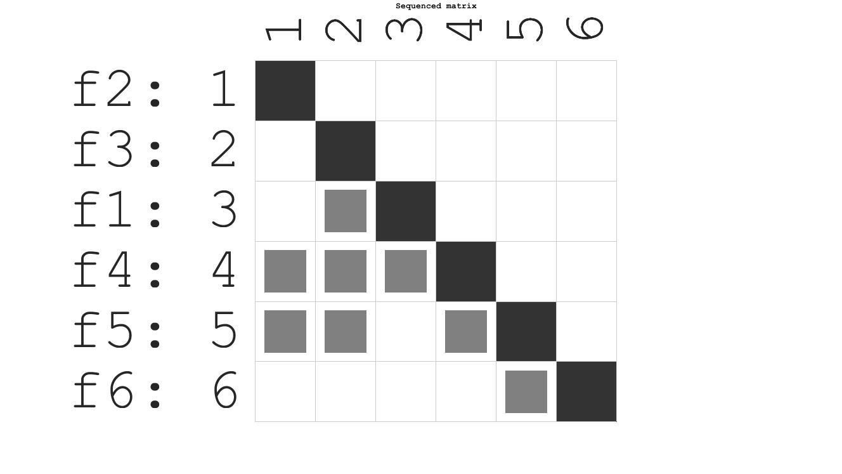
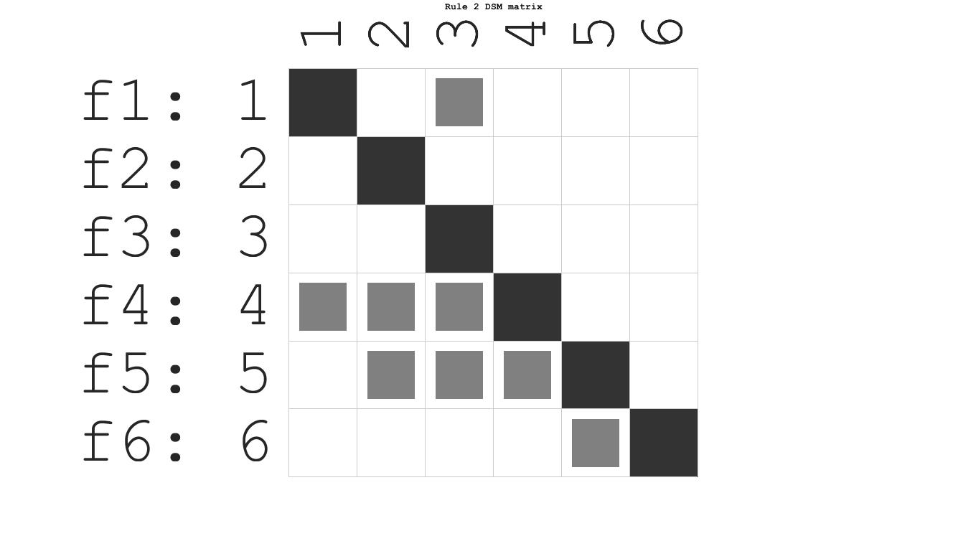
Second rule DSM

Slide 9
Meeting with Matthias
Simple AutoRef integrated with Tech United code, Simulator
Ball In/Out detection with trivial proximity-based assignment of last player touched
Uses ball position data directly generated by Simulator (SIM2TURTLE)
Commands for RefBox are generated as result
Feasibility of integration in this project is low
We propose thorough documentation of Matthias’ system with recommendation for use by future groups
2o21 MSD AutoRef Project

Slide 10
THANK YOU

